Slide 1
Linux 102 Lab

Slide 2
Linux 102 Lab
This is a continuation to the Linux 101 introduction to the Linux command line
Materials needed
Linux Machine
Software Tools used
Linux Terminal

Slide 3
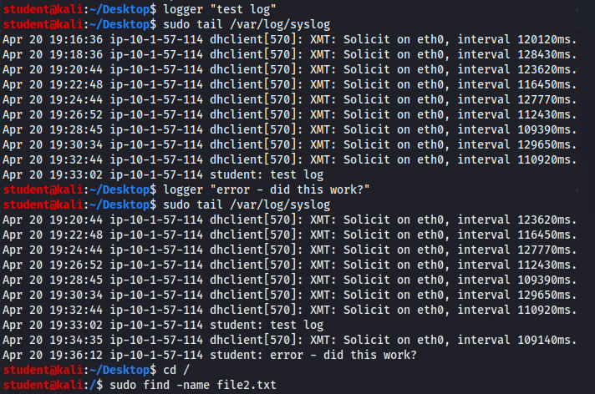
The Linux 102 Lab
Options/Flags
Superuser
Searching
chown/chmod
syslog

Slide 4
Options/Flags (Watch)
An option/flag gives more options for each command
Let’s look at the InsideFolder (from the Move/Copy exercise)
The InsideFolder should be on the desktop with a text file inside
Navigate to the Desktop
Try to copy (cp) the InsideFolder into the other folder
cp InsideFolder OtherFolder
What is our error message?

Slide 5
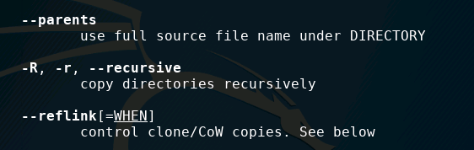
Options/Flags (Watch)
The error message tells us that “-r not specified”
Let’s copy the file using the -r option/flag
cp -r InsideFolder OtherFolder
What does the -r option/flag mean? Let’s look at the manual for the cp command:
man cp
Merriam-Webster defines recursive as a procedure that can repeat itself indefinitely
From the Manual for the cp command

Slide 6
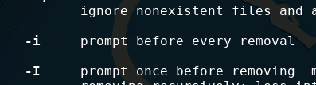
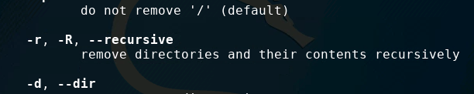
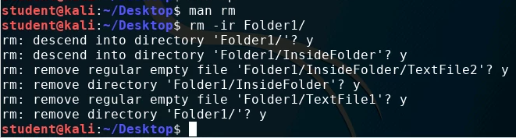
Options/Flags (Watch)
Look at the manual for the rm command
What is the purpose of the -i option/flag?
What is the purpose of the -r option/flag?
Let’s remove the directory on the desktop with the other directories and files inside of it using the -i and -r options.
rm -ri FileName

Slide 7
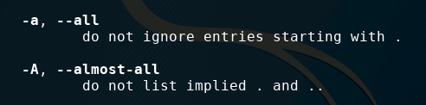
Options/Flags (Together)
Read the manual for the ls command man ls
What is the purpose of the -a and -A options?
Exit out of the manual typing “q”
Create a file on the Desktop that starts with a “.” touch .FileName
Create other files/directories as well
Why doesn’t this file show? The “.” hides the file
List all the non-hidden files on the Desktop ls
List all the files on the Desktop ls -a
List all the files on the Desktop (hiding the “.” and “..”) ls -A

Slide 8


Options/Flags (Together)
Open the manual for the touch command man touch
What is the purpose of the -t option?
How would we use the -t option to change the “Modified date” of a text file? touch -t 198910150830 NewFile
What does the 198910150830 change the modified date to?
October 15, 1989 at 8:30am
Verify that the “Modified date” has changed
Right-click on the file, open “Properties”

Slide 9
Options/Flags (On Your Own)
What files are hidden inside of the /tmp directory?
In the Home directory, copy the Downloads directory to the Desktop
What is the purpose of the -v option for the mkdir command?
What about the -v option for the rmdir command?
Use the -v option when making a directory on the Desktop
What did you notice?
Use the -v option when removing the directory from the Desktop
Did the -v option do what you expected?

Slide 10
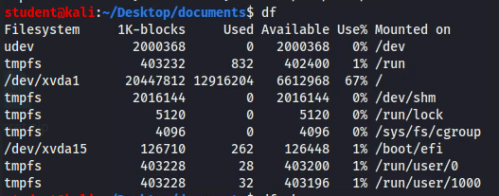
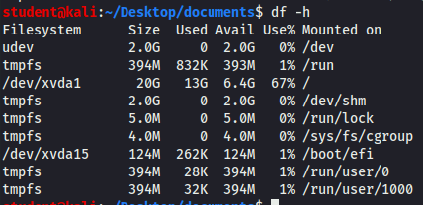
How much storage?
Are you curious how much storage is on your disks and how much is being used?
Run the df command
df
For “human readable”, run this command
df -h

Slide 11

Superuser (Watch)
What is the superuser?
This is the system administrator for a Linux OS
What happens if a user needs superuser powers?
Try to view the /etc/shadow file
cat /etc/shadow
Notice, a standard user does not have enough permissions to view this file

Slide 12
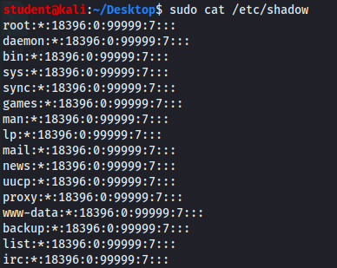
Superuser (Watch)
Use the sudo command to view the file
sudo cat /etc/shadow
Enter the superuser password if prompted
Notice, the user is now able to view the /etc/shadow file
Please Note: sudo stands for “SUperuser DO”.
sudo cat /etc/shadow can be read as “superuser do this: concatenate the shadow file with the Terminal”

Slide 13
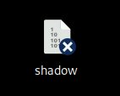

Superuser (Together)
Attempt to copy the shadow file to the Desktop without superuser privileges
cp /etc/shadow route_to_Desktop
Copy the shadow file to the desktop with superuser privileges
sudo cp /etc/shadow route_to_Desktop
Verify that the shadow file is on the Desktop

Slide 14
Superuser (On Your Own)
Navigate to the Desktop directory
Open the shadow file with the nano editor
Edit the shadow file
Save and exit the Shadow file
Read the shadow file in the Terminal

Slide 15
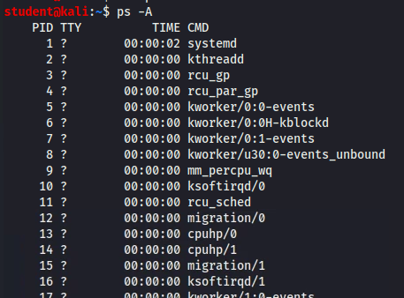
What is processing?
A process is a program being ran/executed by the system
Use the following command to list all the processes running:
ps -A

Slide 16
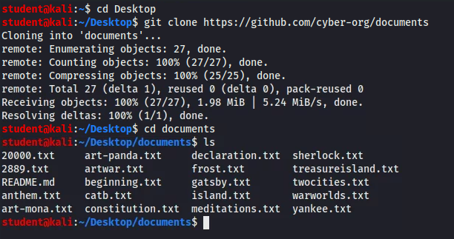

Searching
Make sure the documents are on the Desktop
Navigate to the Desktop
Download all the files
git clone https://github.com/cyber-org/documents
Navigate into the folder
cd documents
Verify the documents folder is on the Desktop

Slide 17
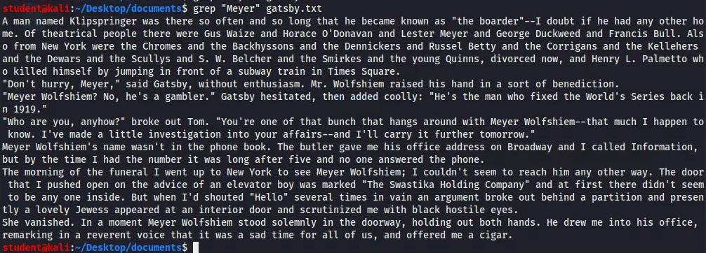
Searching (Watch)
The grep command is used to search for strings
Use this command to search for the character “Meyer” in the Great Gatsby
grep “Meyer” gatsby.txt
You should notice all of the lines from The Great Gatsby that include “Meyer”

Slide 18
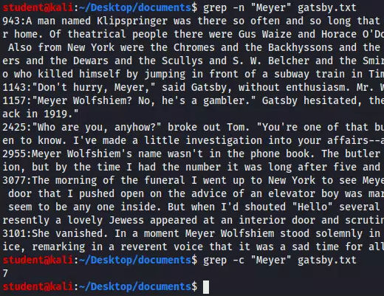
Searching (Watch)
The line numbers where the string “Meyer” is located
Use the following command to list the line numbers where “Meyer” is located in The Great Gatsby
grep -n “Meyer” gatsby.txt
The following command counts the total number of times “Meyer” is in The Great Gatsby
grep -c “Meyer” gatsby.txt
“Meyer” is located in The Great Gatsby 7 times

Slide 19
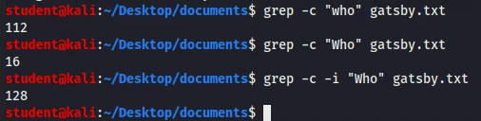
Searching (Watch)
Searching with grep is case sensitive
Notice what the following two commands output with the difference of a capital letter
grep -c “who” gatsby.txt
grep -c “Who” gatsby.txt
Use the flag/option i to ignore case sensitivity
grep -c -i “who” gatsby.txt
Notice, using the option i combines both the totals of “who” and “Who”

Slide 20
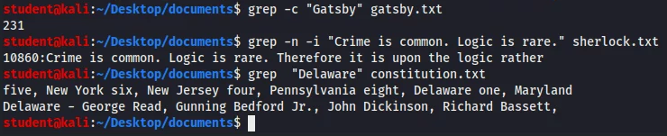
Searching (Together)
How many times is “Gatsby” in gatsby.txt?
grep -n “Meyer” gatsby.txt
What line number is “Crime is common. Logic is rare.” in sherlock.txt?
grep -n -i "Crime is common. Logic is rare." sherlock.txt
How can you find the delegates from Delaware who signed the Constitution (constitution.txt)?
grep “Delaware” constitution.txt

Slide 21
Searching (On Your Own)
How many times is “leagues” in 20000.txt?
How many times is the letter (lowercase or capital) “a” in island.txt?
What four lines is “captain” located on in warw?orlds.txt

Slide 22
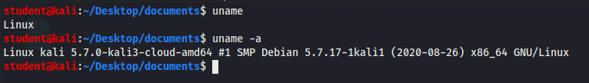
What system?
Curious what system you are operating?
Use the uname command
uname
The -a option will list more information
uname -a

Slide 23

chown/chmod (Watch)
The chown command can change the owner of a file
Add a file to the Desktop
touch file.txt
List the owner of the file
ls -l file.txt
Here, student is the owner of this file

Slide 24
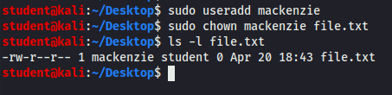
chown/chmod (Watch)
Change the owner of the file
Add a user named “mackenzie”
sudo useradd mackenzie
Change the file to mackenzie as the owner
sudo chown mackenzie file.txt
List the owner of the file
ls -l file.txt
Verify that mackenzie is now the owner of file.txt

Slide 25
chown/chmod (Watch)
Look at the permissions of the file
List the permissions of the file
ls -l file.txt
Here, the owner has rw rights (read and write)
Here, all others have r rights (only read)
Here, the group has r rights (only read)

Slide 26

chown/chmod (Watch)
Change the permissions of the file
sudo chmod 752 file.txt
List the current permissions
ls -l file.txt
1 | Execute
2 | Write
4 | Read
Here, the owner has rwx rights (read, write, and execute)
Here, all others have w rights (only write)
7 = 4 + 2 + 1
Thus, 7 is Read, Write, and Execute
5 = 4 + 1
Thus, 5 is Read and Execute
2 = 2
Thus, 2 is Write
Here, the group has r and x rights (read and execute)

Slide 27

chown/chmod (Together)
Create a new user named “jordan”
sudo useradd jordan
Create a new file named “file2.txt”
touch file2.txt
Make jordan the owner of the file
sudo chown jordan file2.txt
Verify that jordan is the owner of the file
ls -l file2.txt

Slide 28

chown/chmod (Together)
Give everyone read, write, and execute permissions for the file2.txt
sudo chmod 777 file2.txt
Verify that everyone has these permissions
ls -l file2.txt

Slide 29
chown/chmod (On Your Own)
Create a new user named “cj”
Make cj the owner of file2.txt
Change the permissions of file2.txt so that only cj (the owner) has read and write permissions, but not executable. No one else has any permissions
Verify the permissions were changed

Slide 30
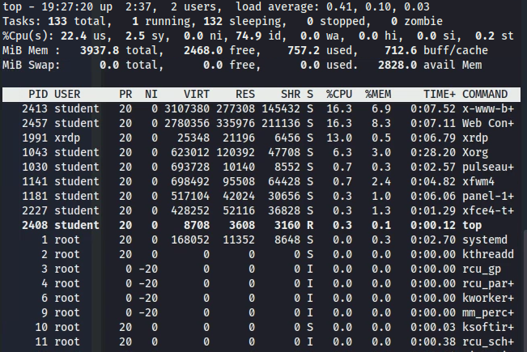
Top
Use top to see how much memory each process is currently using
top
CTRL+C to exit

Slide 31
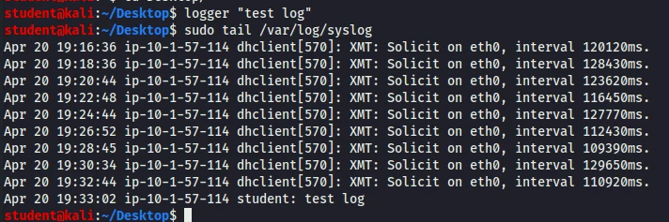
syslog (Watch)
You can write to the system’s log using the logger command
Write a log
logger “test log”
List the last 10 lines of the syslog
sudo tail /var/log/syslog
Verify that the test log was stored in the syslog

Slide 32
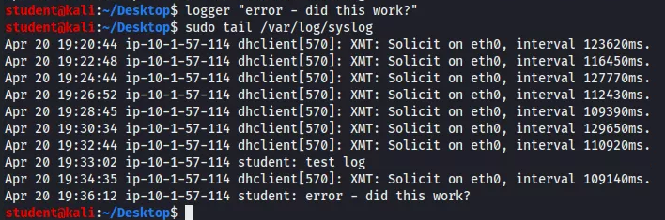
syslog (Together)
Write a log that says “error - did this work?”
logger “error - did this work?”
Verify that the log was filed
sudo tail /var/log/syslog

Slide 33
syslog (On Your Own)
Write your own custom log commands
Send multiple logs!
Verify the commands were sent to the system’s log

Slide 34
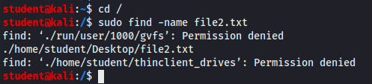
Finding things
You can use the find command to locate documents on a system
Navigate to the root directory
cd /
Search for the file2.txt file
sudo find -name file2.txt
Verify that the command found the location of the file2.txt

